Slide 1


-----------
Hybrid Clustering Technique for MRI Brain Segmentation to Identify Vestibular Schwannomas
Yves Greatti & Heather Grimaudo
EN.585.703.81.FA24 Applied Medical Image Processing

Slide 2
INTRODUCTION
Background:
Brain MRI segmentation is critical for diagnosing and planning treatment for various pathologies.
Manual segmentation is time-consuming and prone to error; automated methods offer efficiency and reproducibility.
Focus of Study:
Vestibular schwannomas: Benign tumors on the vestibulocochlear nerve with unique MR imaging features.
Challenge: Improve segmentation accuracy using hybrid clustering methods.

Slide 3

PROJECT IDEA
Implement and evaluate a hybrid segmentation algorithm combining fuzzy C-means and a modified bat algorithm on MR imaging to identify vestibular schwannomas.

Slide 4
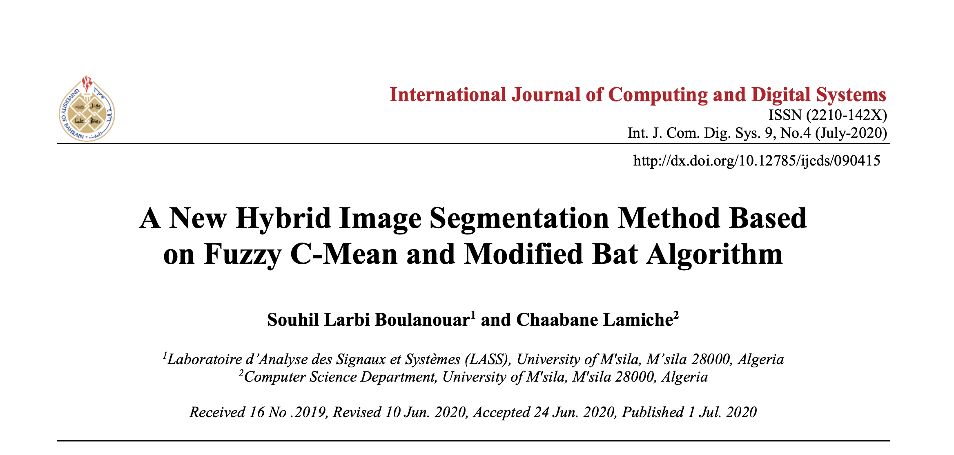

Slide 5
PROBLEM STATEMENT
Fuzzy C-Means (FCM) is widely used but has drawbacks:
Sensitivity to noise.
Dependence on initial parameters.
Tendency to converge to local minima.
Objectives:
Combine FCM with a Modified Bat Algorithm (MFBAFCM) to address these limitations.
Improve segmentation metrics such as cluster compactness and separation.

Slide 6
METHODOLOGY
Step 1:
Fuzzy C-Means (FCM) algorithm: Probabilistic clustering assigns pixels to clusters with degrees of membership.
*Shortcomings: prone to noise and poor initialization.
1
Step 2:
Bat Algorithm (BA): Inspired by echolocation in bats, optimizes cluster initialization.
*Uses frequency, loudness, and pulse rate to guide optimization.
*Fitness function minimizes intra-cluster distance and maximizes cluster validity.
2
Step 3:
Hybrid Approach: BA initializes clusters for FCM, which refines them for optimal segmentation.
3

Slide 7
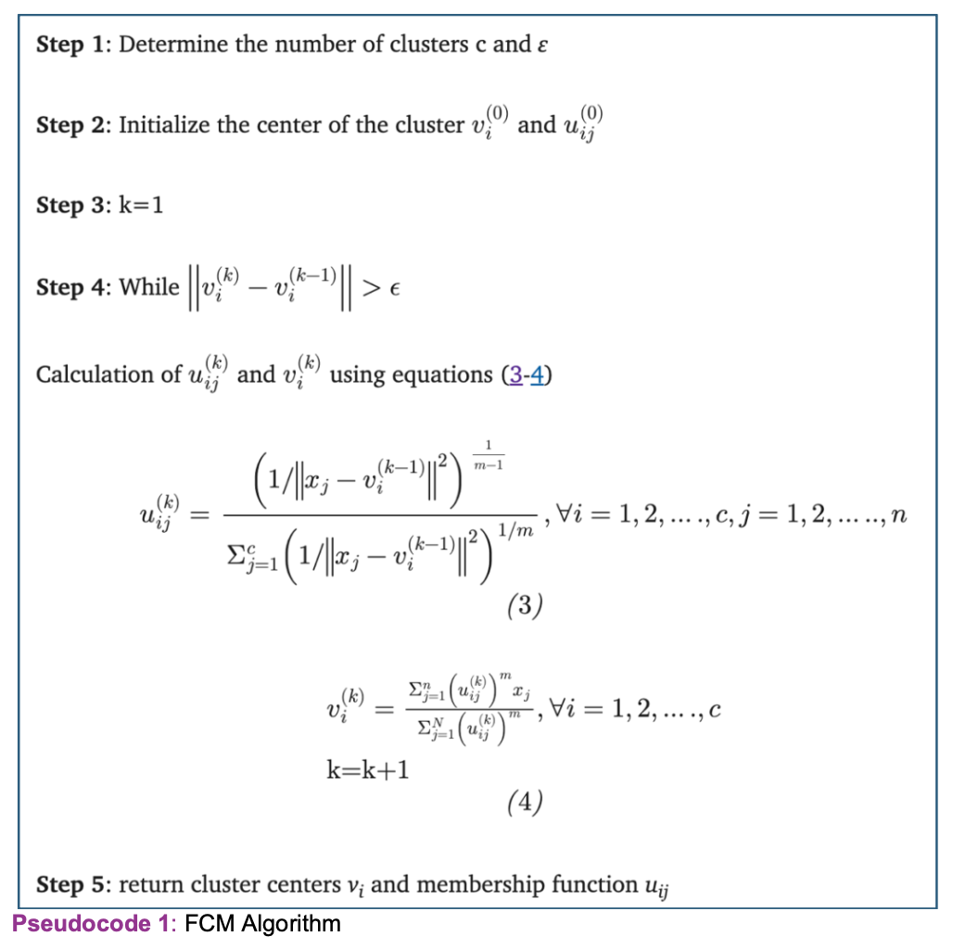
STEP 1: Fuzzy C-Means (FCM) algorithm

Slide 8
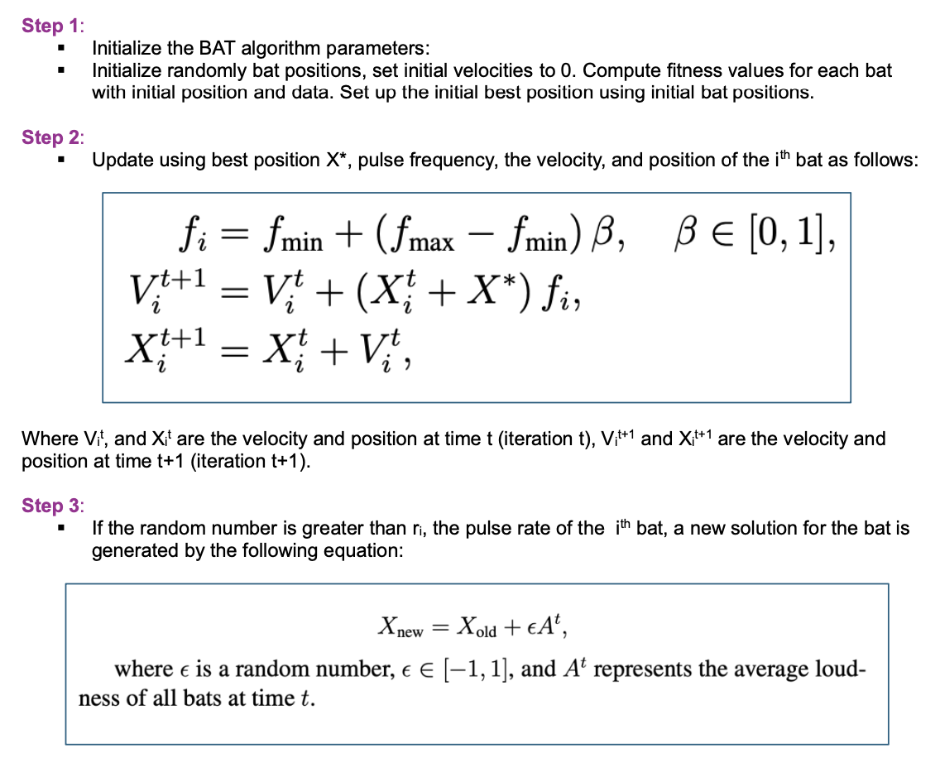
STEP 2: Bat Algorithm (BA)

Slide 9
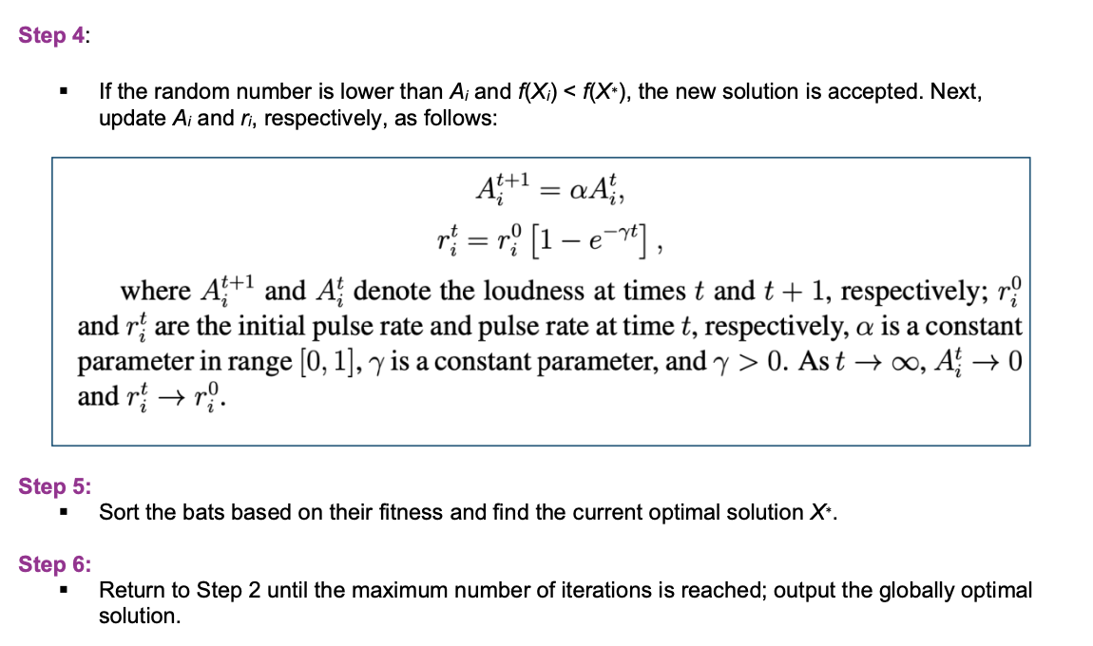
STEP 2: Bat Algorithm (BA)

Slide 10
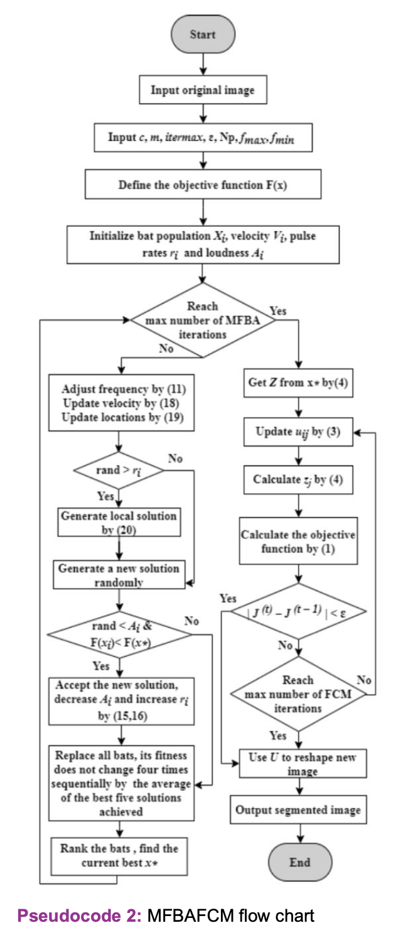
STEP 3: Hybrid Algorithm (MFBAFCM)

Slide 11
IMPLEMENTATION
Dataset:
MRI images of 242 patients with vestibular schwannomas from TCIA.
T1-weighted post-contrast images.
Preprocessing:
Median filtering for noise reduction.
Intensity normalization and sliding kernel filters to preserve edges.
Binary masks created using DICOM data to outline tumor regions.
Training and Testing:
80% training, 20% testing.
Tumor features (intensity range, size) used for segmentation.

Slide 12
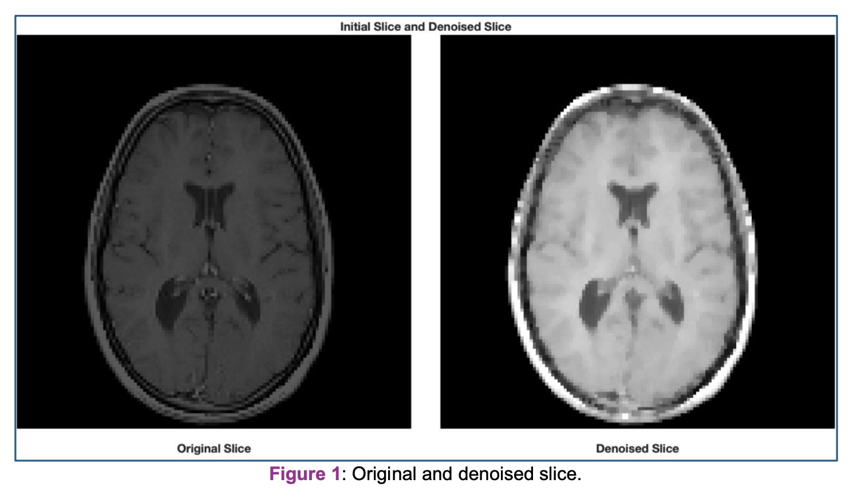

Slide 13
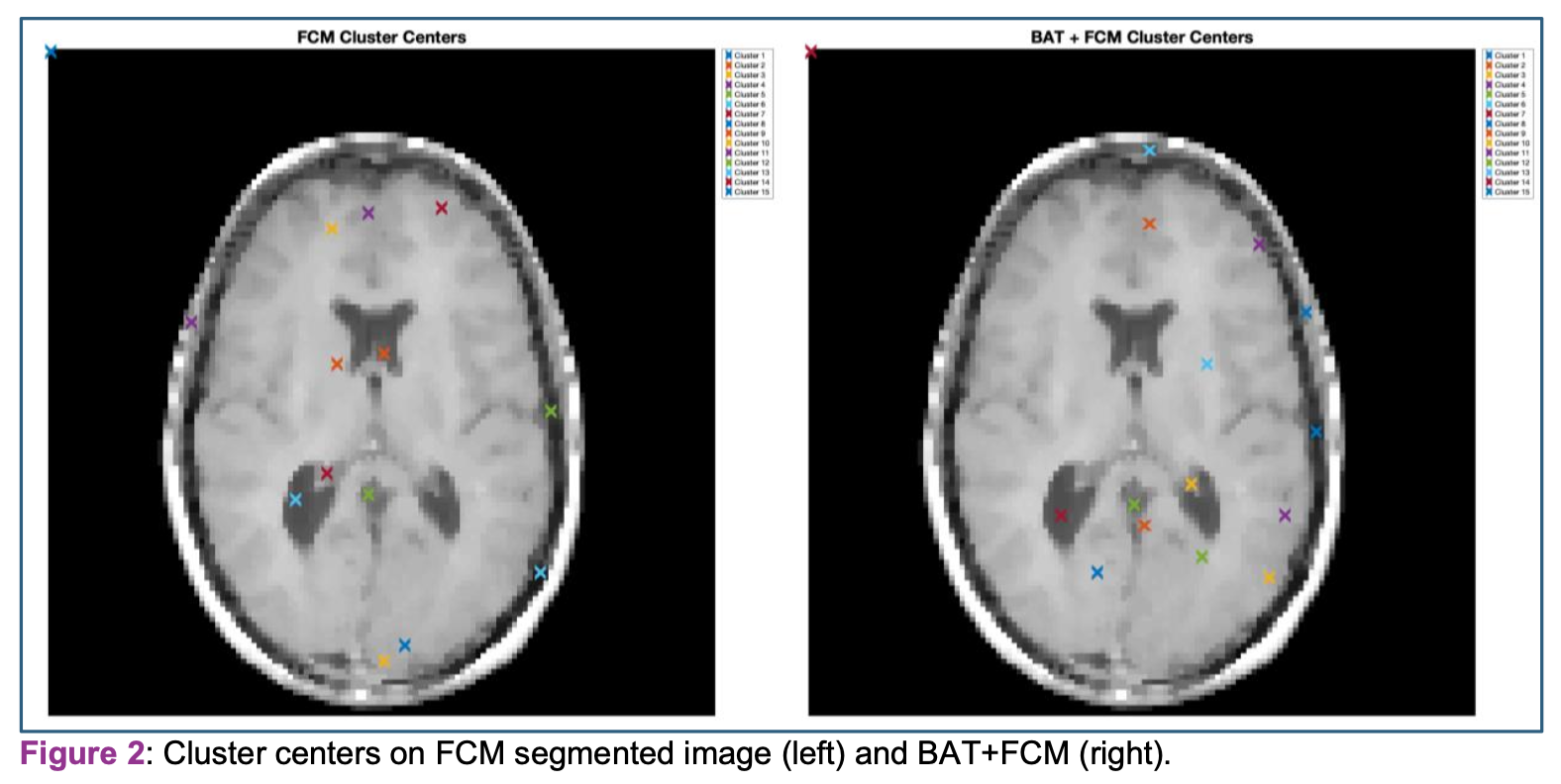
RESULTS
Performance Metrics:
Partition Coefficient (PC): Increased with BAT+FCM (0.667 vs. 0.654 for FCM).
Classification Entropy (CE): Decreased with BAT+FCM (0.865 vs. 0.892 for FCM).
Fuzzy Separation Index (S): Smaller with BAT+FCM, indicating better clustering.

Slide 14
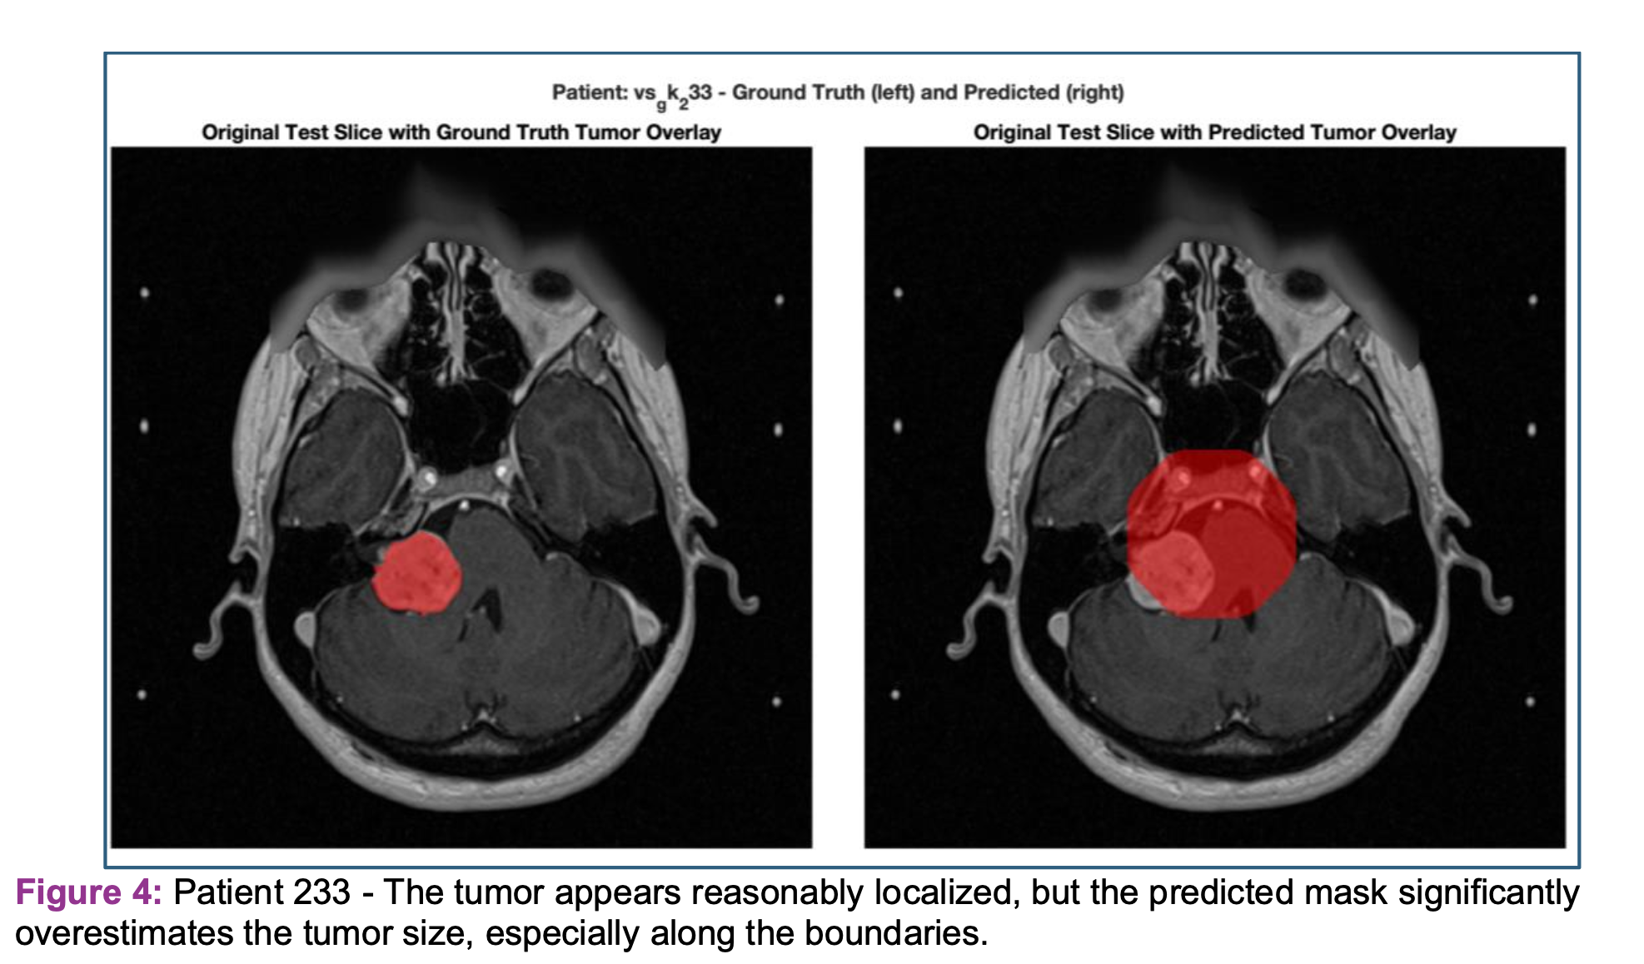

Slide 15
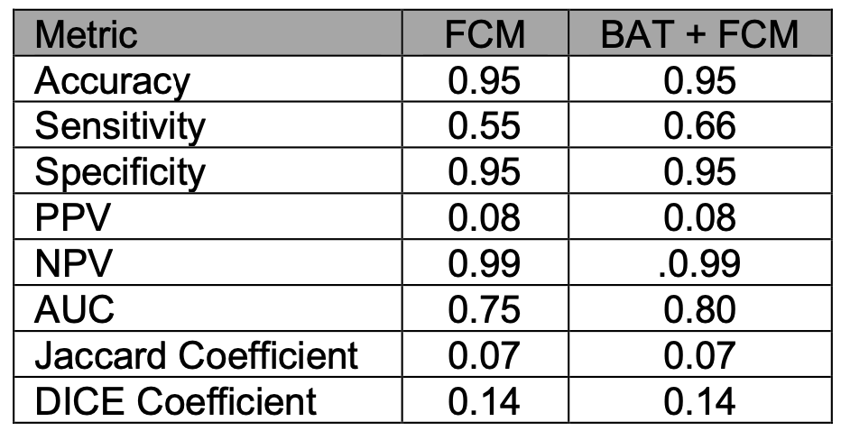

Suggestive of significant over-segmentation or inclusion of false positives in the tumor predictions.

Slide 16
LIMITATIONS
Observed Issues:
Over-segmentation: Predicted tumor masks often exceed actual tumor boundaries.
Boundary inaccuracies: Limited precision along irregular edges.
Low Positive Predictive Value (PPV): Only 8% of predicted tumor pixels were accurate.
Insights:
Histogram matching showed limited improvement in results.
Reliance on static parameters may reduce adaptability.

Slide 17

CONCLUSIONS
Key Findings:
BAT+FCM improves segmentation accuracy compared to FCM alone.
Enhances cluster initialization and reduces noise-related artifacts.
Over-segmentation with poor PPV.
Implications for Clinical Practice:
Supports better treatment planning by improving tumor localization.
Can potentially streamline workflows for radiologists and surgeons.
Future Directions:
Adaptive parameter tuning.
Larger datasets for validation.
Explore deep learning models to further enhance performance.

